Slide 1
San Francisco Crime Analysis
PUJA KUMARI: 50496791

Slide 2
Problem Statement
San Francisco's vibrant culture and esteemed universities provide an ideal setting for graduate students, but potential residents should be mindful of the city's high crime rates. When considering a move from Buffalo, prioritizing neighborhoods like Pacific Heights and Inner Sunset can offer a balance of the SF lifestyle with lower crime rates.

Slide 3
Introduction
We would like to know the nicest neighborhoods in San Francisco that have the lowest crime rates, in case we decide to move there after graduating from Buffalo.
2
1
3
4
Data Cleaning
Data Preprocessing
EDA
Model
Checking the dataset for null values or missing values.
Outlier Detection in both numerical and categorical data.
Analyzed and visualized the dataset to uncover patterns and insights.
Time Series Analysis using different models.

Slide 4
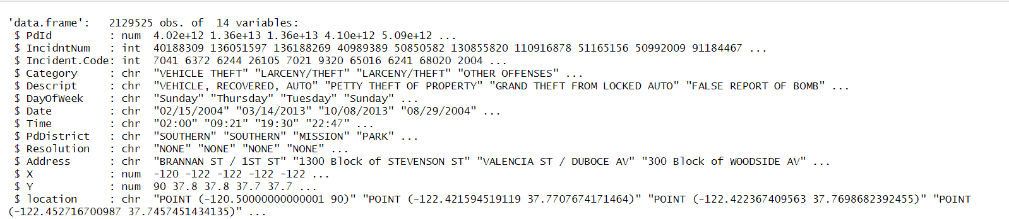
Dataset
The dataset is a detailed repository of reported incidents, encompassing incident specifics like date, time, year, and categorization by description. Each incident is uniquely identified by an incident ID. Additionally, it contains information on resolution status, geographical coordinates, and attributes such as police district and neighborhood. It has 787K criminal observations.

Slide 5
DATA CLEANING
01

Slide 6
Data cleaning is a crucial step in the machine learning pipeline as the quality of the data significantly impacts the performance and reliability of the models.
Handling the missing values: The dataset had only one missing value in the PdDistrict column and in just one row.

Slide 7
DATA PREPROCESSING
02

Slide 8
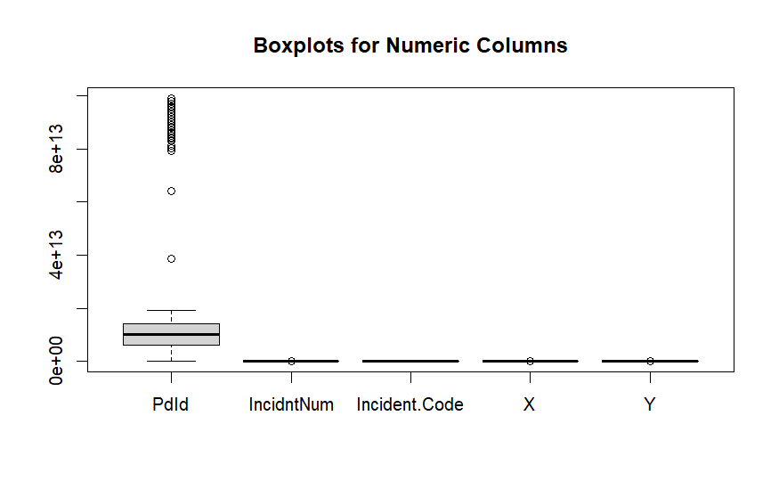
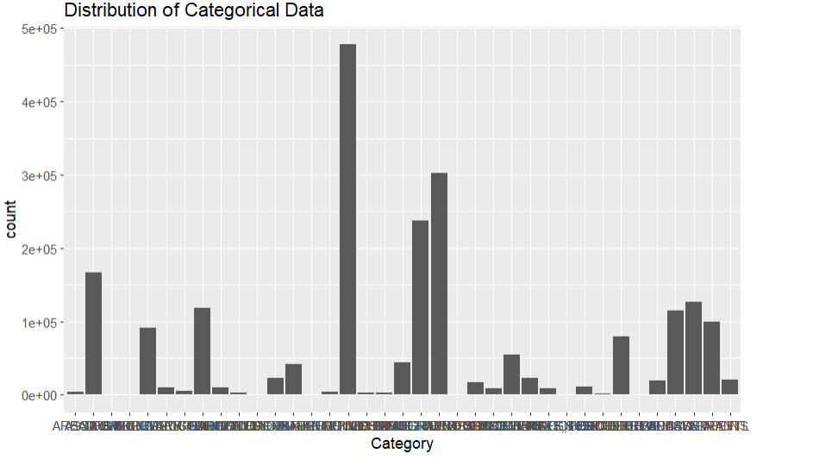
OUTLIER DETECTION:
We dealt with the outliers in the numerical features here.
Only PdId had significant number of outliers so imputed the outliers using the Interquartile Range.
Some of the features which we had were categorical features.
This bar chart displays the frequency of incident categories.
Any extreme case will be considered as an outlier.

Slide 9
Analysed the data based on which category of crime is the largest in San Francisco.
EDA (Exploratory Data Analysis)
Which district in San Francisco has the maximum crime rate.
During which time of the day and which day of the week the crime rate is the maximum.
Till 2018 which year and which month of the year had the maximum crime rate.

Slide 10
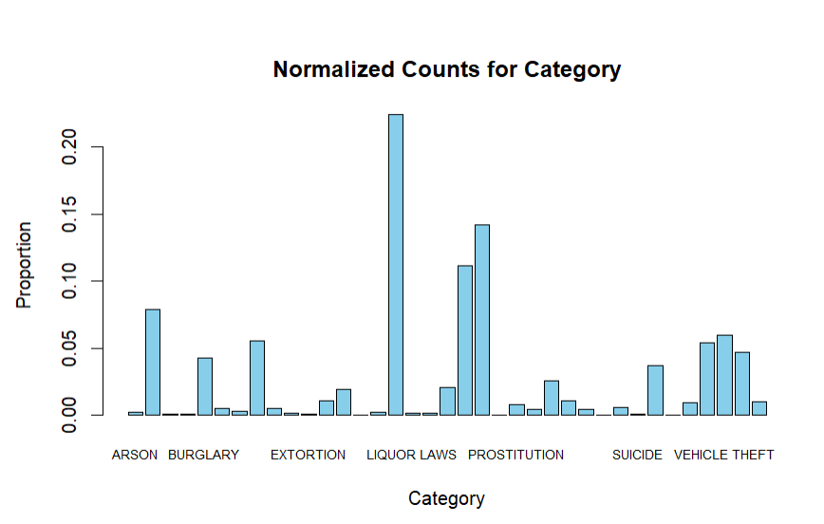
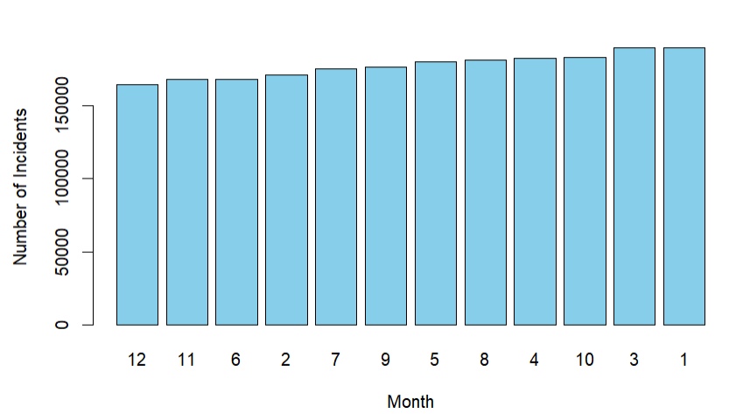
We found some interesting results. For instance, among all types of crime. Liquor Laws is the highest form of crime happening in San Francisco.
January and March both have the most number of the incidents, as opposed to the holiday seasons (in November and December).

Slide 11
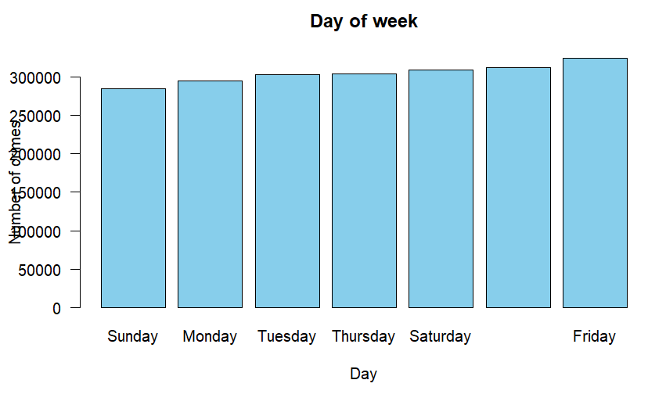
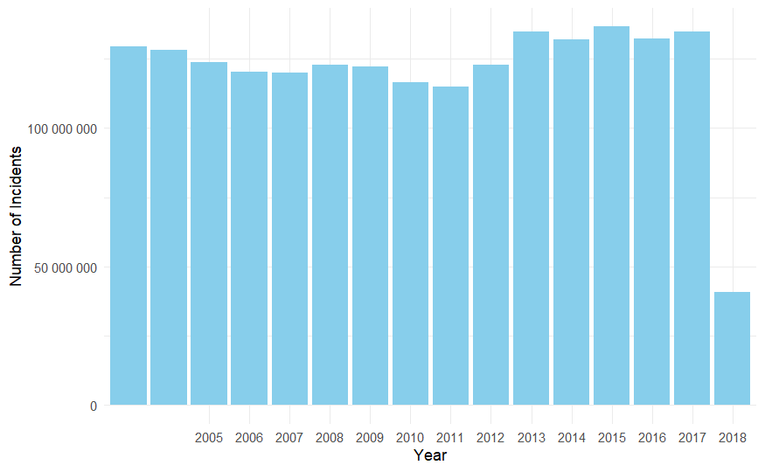
Fridays, with increased social activities and larger crowds, often experience a higher frequency of reported crimes.
Sundays, conversely, tend to be relatively safer, with a lower occurrence of reported criminal incidents compared to other days of the week.
2015 has the maximum crime rate .
The crime rate has drastically increased after 2011, 2018’s data is incomplete.

Slide 12
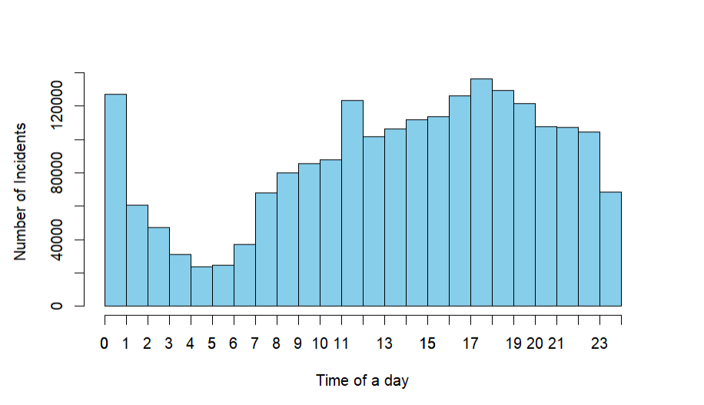
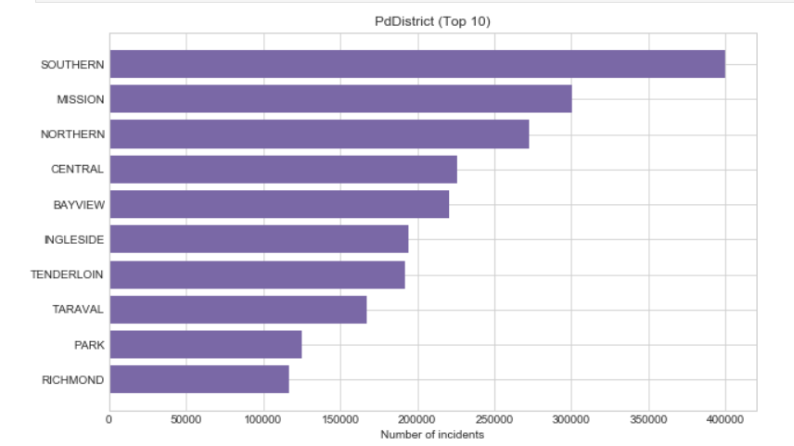
Midnight and Noon are the times when the maximum crime rate occurred.
Southern district in San Francisco has the highest crime rate.

Slide 13
Modelling
02

Slide 14
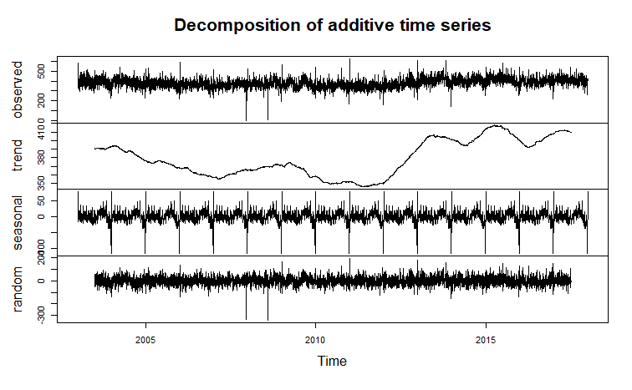
A non-flat trend suggests a changing number of crime incidents over time.
A distinct pattern in the seasonal component may indicate consistent variations in crime rates linked to factors like weather, holidays, or seasonal events.
A large random component implies the existence of unaccounted factors influencing crime incidents beyond the trend or seasonal components.
Notes:
As the trend is not flat, it suggests that the number of crime incidents is changing over time.
A clear pattern in the seasonal component might indicate specific times of the year when crime rates are consistently different, which could be due to various factors such as weather, holidays, or other seasonal events.
If the random component is large, it may imply that there are other factors affecting the crime incidents that are not captured by the trend or seasonal components.

Slide 15
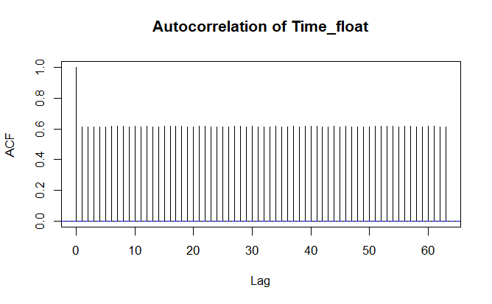
ACF plot still shows high autocorrelation at all lags, so we considering of using models that can capture such behavior, like seasonal ARIMA or SARIMA.

Slide 16
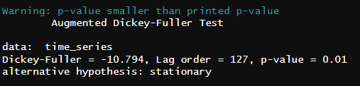
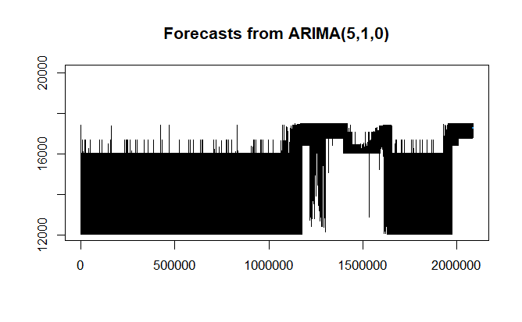
ARIMA (Autoregressive Integrated Moving Average) is a time series forecasting model combining autoregressive, differencing, and moving average components. Represented as ARIMA(p, d, q), it predicts future values based on historical data.
ADF test shows that the data is stationary which is required fo the ARIMA model.

Slide 17
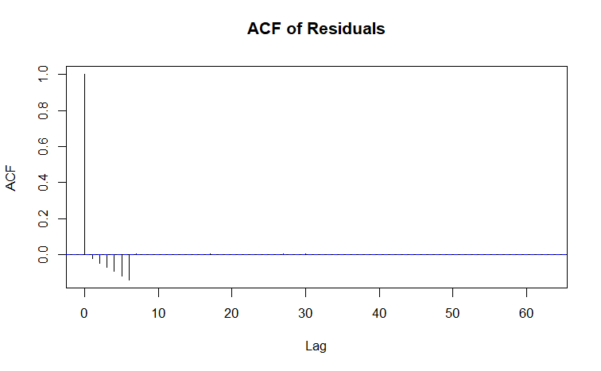
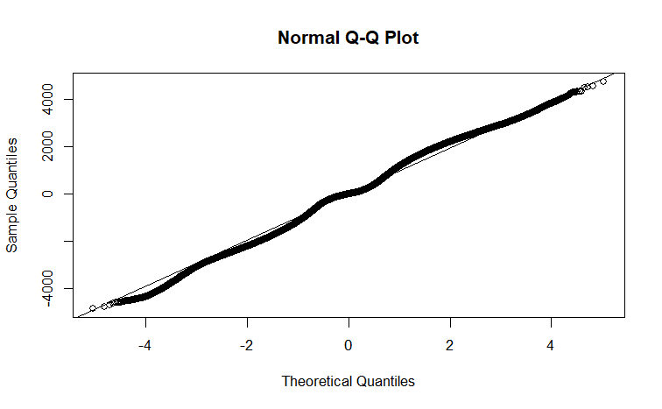
ACF of Residual graph shows some certain spikes at certain lags, which means that there is some structure in the residual that the model has not captured.
Deviation from the straight line on the Q-Q plot shows that means that the model needs further investigation or refinement.

Slide 18
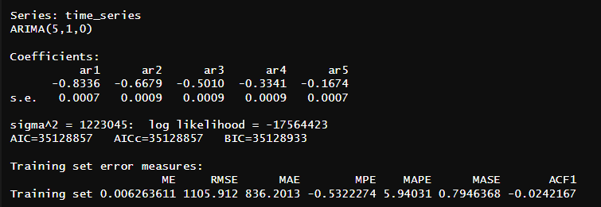
The log likelihood represents the logarithm of the likelihood function, which is a measure of how probable the observed data is given the parameters of the ARIMA model.
The higher the log likelihood, the better the model is at explaining the observed data.

Slide 19
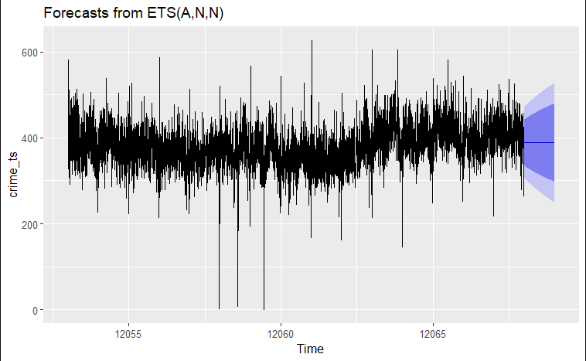
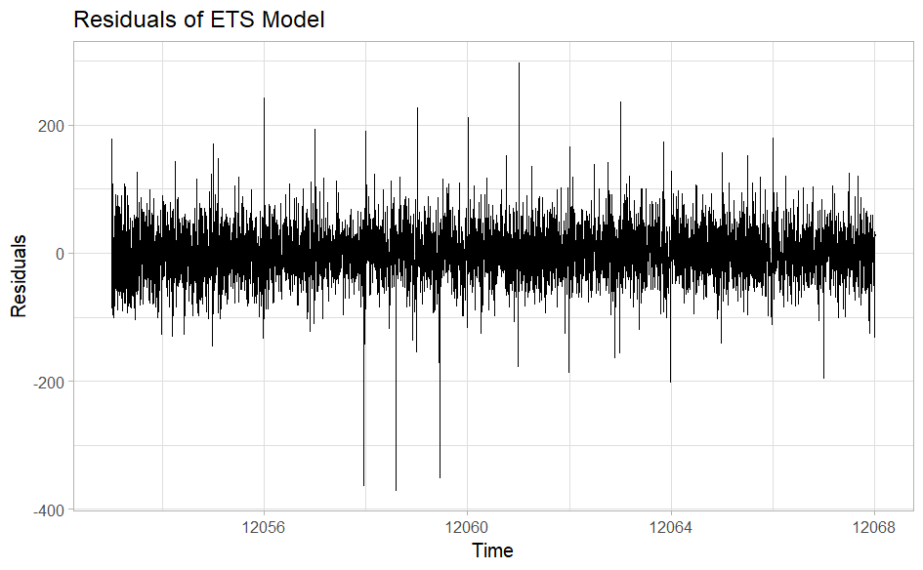
ETS
The black line indicates historical crime data, highlighting the model's fit to past observations. The forecast, depicted by the blue shaded area, projects crime counts into the future without suggesting significant changes, implying an expectation of similar variability as seen historically. The broadening confidence intervals in the forecast period represent increasing uncertainty over time. Overall, the model suggests that crime counts are expected to continue in a pattern consistent with recent history.
The plot of the residuals from our ETS model seems to show that the residuals are centered around zero and have constant variance over time, which are good indicators.

Slide 20
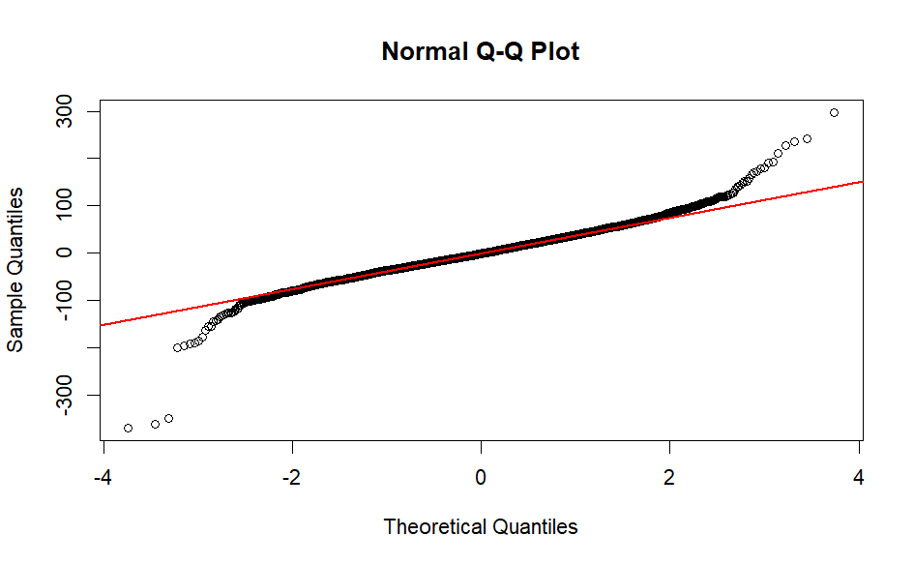
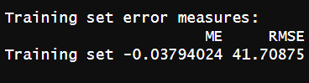
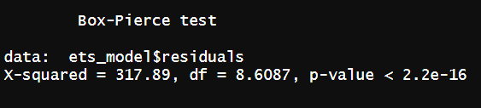
Our ETS model residuals appear to be mostly normally distributed with some possible outliers or extreme values, especially on the lower end.
The Box-Pierce test results suggest that there is very strong evidence of autocorrelation in the residuals of our ETS model. This means that the model may not be adequately capturing all the patterns in the time series data, which could potentially affect the accuracy of our forecasts.

Slide 21
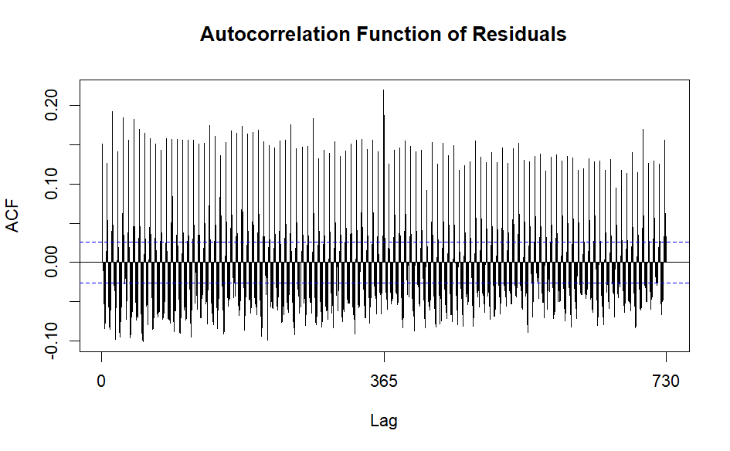
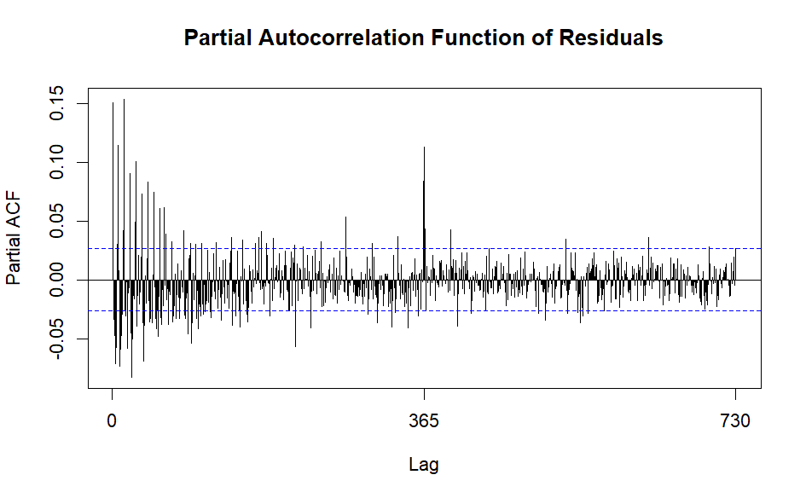
ACF AND PCF
ACF Plot: Few spikes beyond confidence bounds, suggesting possible autocorrelation at specific lags
PACF Plot: Mostly within confidence bounds, with occasional significant spikes
Implication: While the ETS model captures much of the data's pattern, there may be room for improvement, especially at lags with significant spikes.

Slide 22
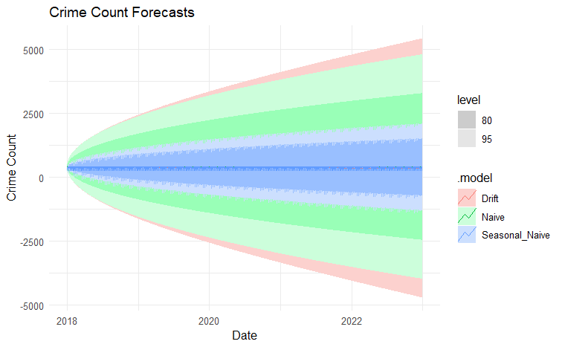
Drift, Naive and Seasonal Naive:
Applied three different models, Drift, Naive and Seasonal_Naive and the rmse for all the three is almost the same.

Slide 23
Future Scope
Refinement of Models: Further investigation into why simpler models outperform sophisticated ones could be explored. It might involve analyzing the underlying characteristics of the time series data to understand why complex patterns might not be adequately captured by more advanced models.
Collaboration and Stakeholder Engagement: Involve stakeholders, law enforcement agencies, and domain experts in the analysis process to gain deeper insights into the factors influencing crime rates and to tailor models to better suit practical needs.
Ensemble Techniques: Consider employing ensemble methods that combine multiple models to potentially improve predictive performance. Techniques like model averaging or stacking might mitigate the limitations of individual models.
Real-Time Analysis: Develop real-time forecasting capabilities to continuously monitor and update crime rate predictions. This could assist law enforcement agencies in proactive decision-making and resource allocation.
By focusing on these future avenues, it's possible to enhance forecasting accuracy and gain a more nuanced understanding of the dynamics of crime rates, thereby contributing to more effective crime prevention and management strategies in San Francisco.

Slide 24
Conclusion
"In this analysis of San Francisco's 15-year crime data, key patterns emerged, showcasing “Theft’' as the most frequent crime type, midnight and noon as peak crime periods, and Fridays as the most prone day. January and March saw higher incidents compared to traditional holiday months.
Spatial analysis highlighted areas with higher crime rates, aiding in identifying neighborhoods with lower crime occurrences. Time series analysis revealed crime evolution trends, culminating in an ARIMA model predicting future crime rates. Surprisingly, a simple Mean method displayed superior forecasting ability, implying straightforward data patterns.
Future exploration could involve integrating house price data, crucial for relocation decisions. Overall, while complex models exist, understanding simpler trends is vital for effective decision-making in addressing crime rates."
This encapsulates the main findings and suggests a potential avenue for future investigation, emphasizing the significance of understanding both complex and straightforward patterns for informed decision-making regarding crime and relocation plans.
"By leveraging comprehensive data analysis, this study provides valuable insights into crime trends in San Francisco, aiding informed decisions for individuals considering relocation. Continued exploration, possibly integrating additional datasets, promises further depth in understanding the multifaceted dynamics of neighborhood safety and livability."

Slide 25
THANK YOU

